Slide 1
How To Survive & Thrive With A Middle School Beginner Band
in inceptum finis est
The beginning determines the end.
Notes:
Rachel

Slide 2
Oswego School District #308
Oswego, IL
Notes:
Rachel

Slide 3
Our Students
Insert Short Video
Notes:
Rachel

Slide 4
Bednarcik, Murphy, Plank, Thompson & Traughber JHS
Oswego High School & Oswego East High School
Notes:
Rachel

Slide 5
JHS Band Staff
Rachel Maxwell
Traughber JHS
Dan Harrison
Thompson JHS
Lisa Heemstra
Bednarcik JHS
Meghan Fulton
Plank JHS
Julianna Karvelius
Murphy JHS
Chris Werve
Plank/Thompson
Jessica Corry
Traughber JHS
Margene Pappas
Retired Dir of Bands
Notes:
Rachel

Slide 6
Our History with Beginner Band
Notes:
Margene

Slide 7
“Traditional” Elementary Band
1969-1981
2 or 3 Directors
5th Grade Band
Rotating school day pull-out schedule
Small group like-instrument lessons
Full Band Before or After School
Notes:
Margene

Slide 8
1982-1994 Elementary Band
1982 referendum failed
5th Grade Band
All group lessons after school out of school day
Family Paid Fees for Instruction
Eventually district-paid elementary director position reinstated
Band remained out of school day
Notes:
Margene

Slide 9
Reasons for Our Change
Beginner Band needed to return to in-school curricular program
2 Directors doing (3 Elem Schools, 2 JHS, 1 HS)
Schedule could no longer work with after school conflicts between the programs
System in place was not Best Practice
Notes:
Margene

Slide 10
How We Decided On Our New System
Directors developed several options but favored 6th Gr Beginners
Daily contact during school day-curricular!
Like instr. groups
JR McIntyre, Odessa, TX coached directors on “Texas” system of 6th Gr Beginners
Less attrition
Students advance at a fast and more even rate
Notes:
Margene

Slide 11
Recruiting Time Line & Activities
Notes:
Megan

Slide 12
During 5th Grade School Year-JANUARY
Each band/choir director confirms elementary building feeder schools
Contact JHS Admin to confirm recruitment activities -“No Surprises”
Allow JHS Admin to make initial contact with Elementary Admin if desired
Notes:
Megan

Slide 13
JANUARY
Contact elementary music teachers to set up visits to classes and discuss plans
Review access to standardized test scores of current 5th graders (NWEA)
Contact Elementary Music & Classroom Teachers for student recommendations and feedback
Notes:
Megan

Slide 14
Appointment Dates & Times
Each school’s director determines their dates & times
Dates are usually set just prior to or immediately after Spring Break
A make-up date is scheduled but not released to the public yet
Each school runs 2 initial dates and 1 or 2 make-up dates
Notes:
Megan

Slide 15
Appointment Set-Up Continued
Each student and family has an individual appointment with a director
Each appointment is 15 minutes
Each school runs 2-4 appointments at a time depending upon past demand
A Parent MUST attend! The parent will be able see and understand the selection process.
Notes:
Megan

Slide 16
Keeping Things Coordinated!
The Band Coordinator will make sure by mid-January that:
all elementary schools are contacted by a director
each director has set up dates for elementary school visits
each director has set up appointment dates and times
the online appointment schedule software is up to date, paid & links are active
release all recruiting information to papers, District Communications Administrator & District Web Master
Notes:
Megan

Slide 17
SuperSaas http://www.supersaas.com/
Allows each building to run separate custom schedules
Sends reminders to parents
Builds Initial student database
Costs us approx. $70 to run for 3 months and accommodate all beg. appointments
Notes:
Megan

Slide 18
District-Wide Flyer & Information
Coordinator builds District-Wide flyer with info about Band appointments and Choir
Paper copy given to every 5th grade student
Info sent to local papers
Info is posted on District website, JHS websites, Band websites & each Elementary website
Spanish language version is available
Notes:
Megan

Slide 19
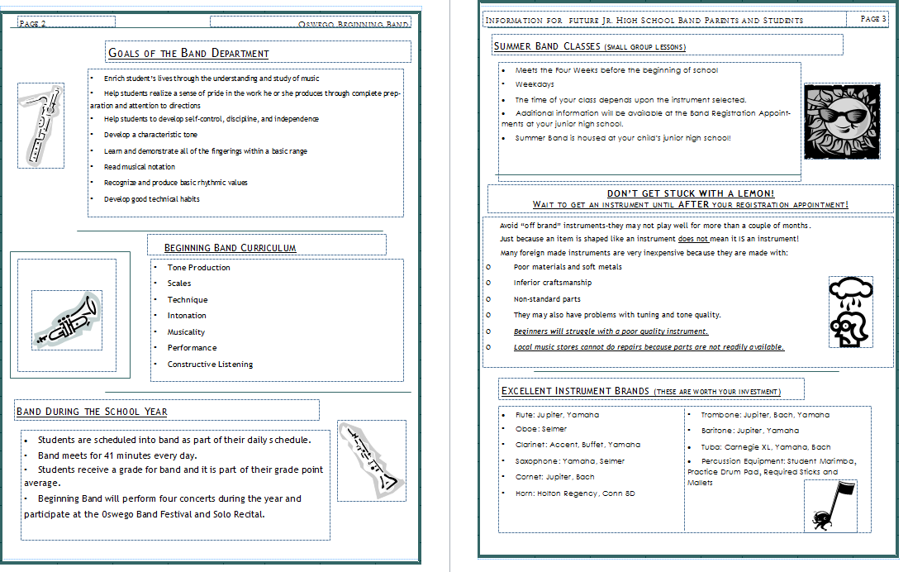
District-Wide Flyer & Information
Notes:
Megan

Slide 20
Elementary Visits ~ FEBRUARY
Band Director visits 5th grade General Music classes or 5th grade classes in assembly format
Notes:
Megan

Slide 21
Elementary Visits
Present info with Posters & Handout
Demonstrate the Instruments
Play “Games” with the “Join Band” info
Info on a Power Point or Prezi (Video & Sound Clips)
Notes:
Megan

Slide 22
Elementary Visits with Student Demonstrations
Small Group of JHS Students take field trip to Elementary to present instruments
Full Band presents instruments at elementary
5th Graders visit JHS to watch Band Presentation
Notes:
Megan

Slide 23
Appointments ~ MARCH & APRIL
Contact Music Dealers to set up tables at appointments
Contact other directors to help with appointment dates
Print appointment lists
Notes:
Megan

Slide 24
Appointment Prep
Make Signs and Charts for Sign-Up Days
Make Parent Packets
Set Up Room with Stations
Notes:
Lisa

Slide 25
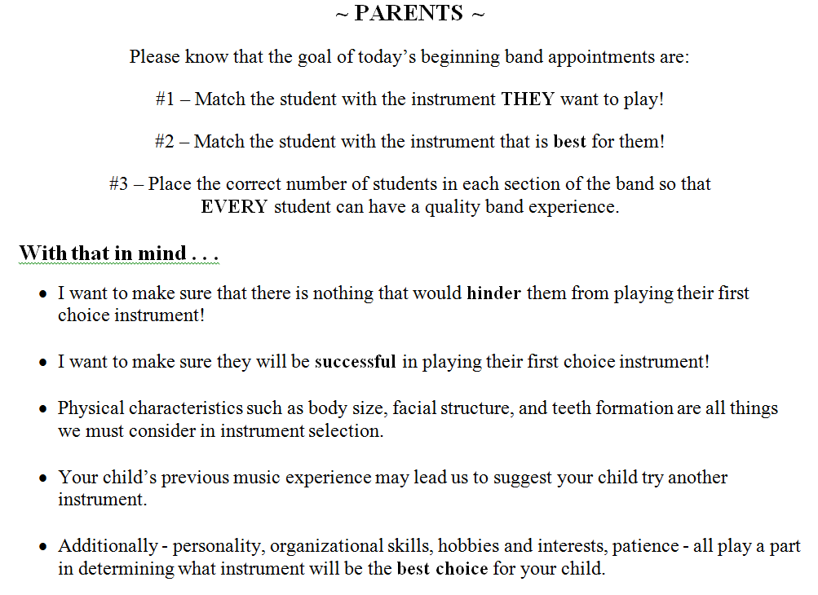
Notes:
Lisa

Slide 26
Master List for Instruments Tally
List Instrumentation Goals
Track Overages and Shortages
Notes:
Lisa

Slide 27
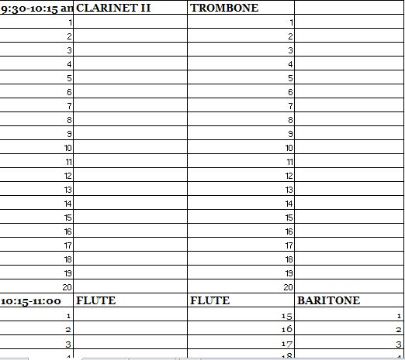
Empty Summer Class Schedule
Notes:
Lisa

Slide 28
Class Sign-up List II
Notes:
Lisa

Slide 29
Parent Packet Student Information Sheet
Notes:
Lisa

Slide 30
Program Overview
Notes:
Lisa

Slide 31
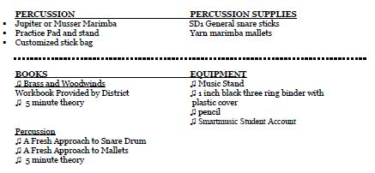
Supply List Required Instruments
Notes:
Lisa

Slide 32
Instrumental Characteristics
Notes:
Lisa

Slide 33
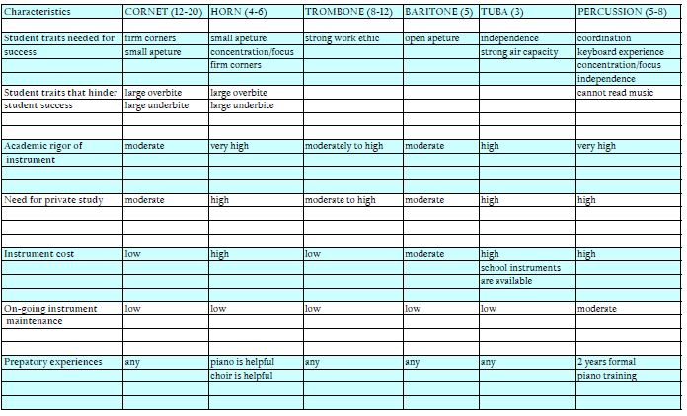
Notes:
Lisa

Slide 34
Appointment Procedures
Students and parents pick up a packet and fill out top sheet
“Student Information”
Appointment movie Insert
Notes:
Julianna

Slide 35
Background Information
Check student’s standardized testing information and make a mental note of the numbers!
Check for any teacher notes
Notes:
Julianna

Slide 36
Appointment Procedures
Parents read through the information packet while the student tries instruments.
This will help with many potential questions from parents.
Notes:
Julianna

Slide 37
Personality & The Learner
Talk with the student.
Ask about their info sheet answers and their interests.
Teams? Homework? Neatness? Work Ethic? Reader?
Notes:
Julianna

Slide 38
Trying the Instruments
Play along with the student to try instruments
Start with the basics first-clarinet, flute, cornet
Once they are successful (or not) move to the next instrument
If the student can NOT get a solid sound on the instrument they CANNOT sign up for it
Notes:
Julianna

Slide 39
Appointment Procedures
Once an instrument is selected, mark the Instrument Tally Sheet and the class list.
Mark final instrument selection on Student Information Sheet for our records.
Give Parents a complete “Postcard”
Notes:
Julianna

Slide 40
Appointment Procedures
Advise parents to order an instrument & supplies from music dealer by June 1st
Notes:
Julianna

Slide 41
Appointment Procedures
Our suppliers have lists in the store and stock the correct brands, mouthpieces, reeds, books, etc.
No substitutes accepted
Notes:
Julianna

Slide 42
Appointment Procedures
Students need all supplies on the list in the Parent Packet
We only accept the brands we list
Educate families and be somewhat flexible when needed
Notes:
Julianna

Slide 43
Build Class Lists ~ MARCH/APRIL
Send woodwind, brass & percussion class lists to counselors to build 6th grade schedules
Organize database for Summer Band classes
Notes:
Julianna

Slide 44
Recruitment~ MAY
Hold 1 or 2 appointment
make-up dates
Confirm late Summer use of building with administration at each site
Send Summer Band class confirmations to parents
Set instrument delivery dates with music companies
Confirm Summer Band teaching assignments
Notes:
Julianna

Slide 45
Summer Band Beginner Classes
Notes:
Chris

Slide 46
Summer Beginner Band
Part of the Summer School Program under Enrichment Courses
We strongly encourage all students to attend every class session
We cannot “require” attendance since it is an enrichment course but the great majority of families are excited to participate
Notes:
Chris

Slide 47
Summer Band Management
Summer staff payroll was covered by the school district for 18 years
With drastic cuts looming we were asked how we could eliminate this expense (2010)
Incorporated into Summer School with a fee for each student
$85 per student for 18 hours of instruction
Notes:
Chris

Slide 48
Summer Band Calendar
Four weeks of instruction prior to the start of the school year
Usually scheduled last week of July through third week of August
Housed at each student’s JHS
Runs Mon through Fri with 45 min classes or Mon through Thur with 60 min classes
Notes:
Chris

Slide 49
Notes:
Chris

Slide 50
Notes:
Chris

Slide 51
Contact Minutes During Summer Instruction
810 minutes of consistent daily instruction
How many weeks (months) of 5th grade pull out classes will it take to see students for 810 minutes?
How much instruction time is spent re-teaching when students do not see a teacher every day?
Notes:
Chris

Slide 52
Summer Band Skill Development
Basics & Benchmarks
Notes:
Jessica

Slide 53
Benchmarks
Designed to teach students the fundamentals of playing which would have been introduced during a year of 5th grade traditional band
These skills should be mastered during Summer Band
Students demonstrate mastery by executing these skills each and every time they play their instrument
Notes:
Jessica

Slide 54
Fundamental Skills
Body Position
Hand/Holding Position
Breathing
Embouchure
Buzzing
Mouthpiece & Head Joint
Characteristic Tone
Articulation
Timing
Notes:
Jessica

Slide 55
Music Literacy
5 Minute Theory Lessons
Identify and demonstrate note values of whole, half and quarter notes
Identify and demonstrate fingerings for five starter notes
Notes:
Jessica

Slide 56
Performance Skills
Correctly demonstrate all exercises individually,
in small groups and in the full group
Notes:
Jessica

Slide 57
Beginning Band During the School Year
Scheduling
Notes:
Dan

Slide 58
Junior High School Schedule
9 Period Day
41 Minute Classes
Day starts at 8:00am
Day ends at 3:00 pm
Notes:
Dan

Slide 59
Junior High School Schedule
Language Arts is Blocked (2 classes)
Math
Science
Social Studies
Gym
Lunch
2 Electives
Notes:
Dan

Slide 60
6th Grade Band Schedules
3 Staff Team
All 6th Graders scheduled into one period
Split into Brass, Woodwind & Percussion Sections (space needed)
Allows Full Band any day needed
Notes:
Dan

Slide 61
2 Staff Team
6th Graders scheduled into three periods
Split into separate Brass, Woodwind & Percussion Classes
2 Directors per class to split into more homogenous groups
Full Band scheduled at lunch or outside of school day

Slide 62
1 1/2 Staff Team, Option 1
6th Graders scheduled into two periods
Split into Separate Brass, Woodwind/Percussion Classes
Full Band scheduled at lunch or outside of school day
Notes:
Dan

Slide 63
1 1/2 Staff Team, Option 2
6th Graders scheduled into two periods
Split into 1 Brass/Woodwind class and 1 Percussion Class
Allows Full Band any day needed (without Perc)
Full Band with Perc scheduled at lunch or outside of school day
Notes:
Dan

Slide 64
1 Staff Member
6th Graders scheduled into three periods
Split into separate Brass, Woodwind & Percussion Classes
Full Band scheduled at lunch or outside of school day
Notes:
Dan

Slide 65
Staffing Classes
An Evolving Process
Notes:
Dan

Slide 66
Vertical, Plan 1
High School and Junior High Directors team teach at both levels together each day
(3 directors, 3 buildings)
Notes:
Dan

Slide 67
Vertical, Plan 2
As Assistant Directors are added they continue to team teach at both levels on a daily basis
Head Directors stay at primary building
Notes:
Dan

Slide 68
Horizontal, Plan 1
High School Directors team teach only at high school each day
Junior High Directors travel to team teach at the junior high level each day (2 buildings each)
Notes:
Dan

Slide 69
Horizontal, Plan 2 & 3
Junior High Assistants travel to team teach at the junior high level each day (split between 2 buildings each)
Junior High Assistants team teach at the junior high level each day at primary building only
Notes:
Dan

Slide 70
Graph of Staff Additions
Notes:
Dan

Slide 71
6th Grade Curriculum
School Year; An Overview
Notes:
Rachel

Slide 72
Course Goals-”Big Picture”
To heighten each students aesthetic awareness through the musical arts
To introduce students to the fundamental skills involved in playing a musical instrument
Notes:
Rachel

Slide 73
Course Goals - ”Big Picture”
To reinforce and develop the fundamentals of music theory and listening skills
To provide students with an ensemble performance experience
Notes:
Rachel

Slide 74
Course Objectives-More Specific
To produce a characteristic tone on individual instruments
To identify and demonstrate a knowledge of musical notation
Notes:
Rachel

Slide 75
Course Objectives
To demonstrate fingerings and positions for the practical range of individual instruments
To develop good individual practice habits
Notes:
Rachel

Slide 76
Course Objectives
To demonstrate a basic understanding of the elements of music.
These include: timbre, dynamics, articulation, rhythm, melody, pitch, harmony, texture, form, expression and style
Notes:
Rachel

Slide 77
Course Objectives
To demonstrate a basic understanding of and ability to perform ensemble playing skills and techniques
To develop problem-solving and evaluation skills applicable to music
Notes:
Rachel

Slide 78
Course Objectives
To develop an aesthetic sensitivity to music
To demonstrate knowledge of music as a creative art form of man in an historical context.
Notes:
Rachel

Slide 79
Assessments
A Sample
Notes:
Rachel

Slide 80
Grading
All electives are graded classes
Elective Grades are included in student eligibility and GPA
District is moving toward “Performance Based Grading”
Behaviors must be tied to specific skill mastery to be graded
Notes:
Rachel

Slide 81
Performance Based Assessments
Formative & Summative
Rubrics & “Tick” Systems
Weekly In-Class Assessments
6 Second Tests
Smartmusic
Workbook
Rhythms/Scales
Concert Music
Notes:
Rachel

Slide 82
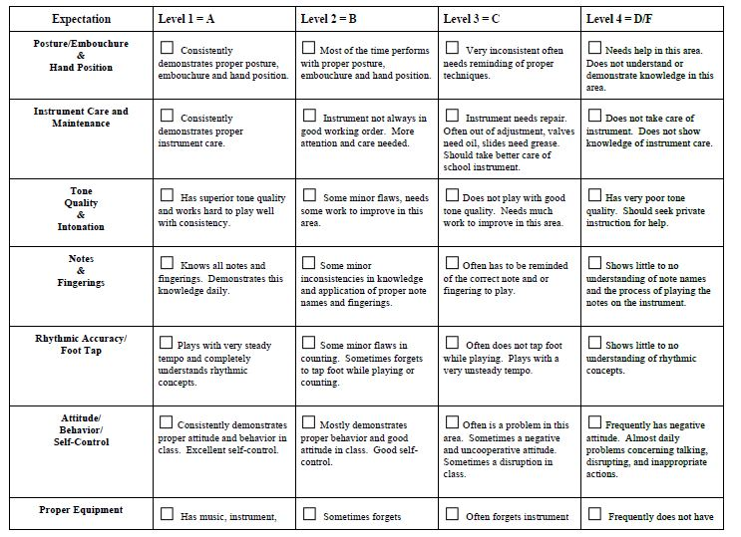
Notes:
Rachel

Slide 83
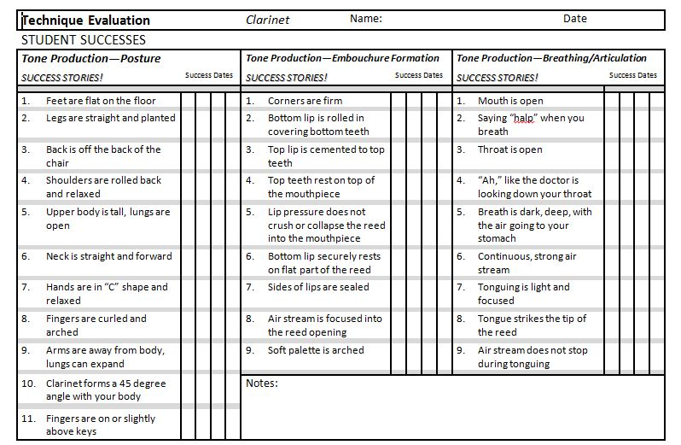
Notes:
Rachel

Slide 84
Written Work
Practice Reflections
Note Name Game
Theory Workbook
Self-Assessments & Reflections of Work/Performances
Notes:
Rachel

Slide 85
Performances
Adjusted for the Needs of Each School
Notes:
Rachel

Slide 86
Performances
Demonstration Concert (October)
Winter Concert (Dec/Jan)
Festival Cycle (Feb/March)
Band Festival (March)
Spring Concert (May)
Solo Recital (Varies)
Notes:
Rachel

Slide 87
Outcomes & Advantages
Our Own Experiences
Notes:
Dan/Rachel

Slide 88
Consistency
We are each our own “feeder” system
Equipment and material standard
Instrumentation
Retention approx 90%
All beginners have the same pedagogical start
All students have 200+ contact minutes each week
All students have daily routines established
Notes:
Dan/Rachel

Slide 89
Skills
Peer modeling & coaching
Small group advantages with limited instrumentation per class
Large ensemble skills developed with 30-90 per class
Student development is rapid with daily contact
Group moves at a fairly consistent rate
Instrument specific instruction is effectively delivered
Notes:
Dan/Rachel

Slide 90
Social & Developmental
Students are physically and emotionally fairly mature
Ensemble “experience” for group buy-in
Very rewarding with frequent performances and fast development
Concerts shared with older students to expose beginners to near future opportunities
Cross section of school culture represented
Strong part of school culture
Notes:
Dan/Rachel

Slide 91
Movie insert
Notes:
Dan/Rachel

Slide 92
Resource Materials
Traughber Band Website:
Traughberband.weebly.com
rmaxwell0515@oswego308.org
Thompson Band Website:
Thompsontigerband.weebly.com
dharrison 0629@oswego308.org
Notes:
Dan/Rachel

